Slide 1
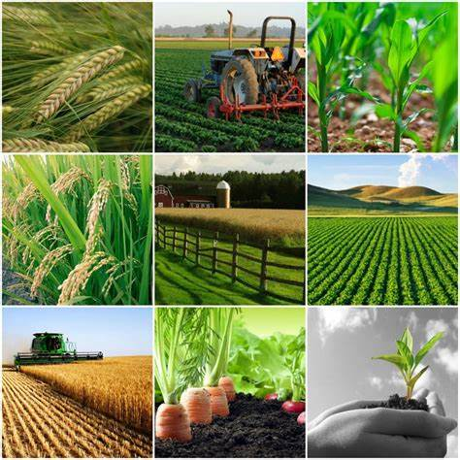
OUTLINE
Objectives
Introduction
Contribution of famous Personalities in Agriculture
Agriculture as the Main Livelihood for Millions in Bangladesh
Role of AI in agriculture
Role of Agriculture in GDP Growth of Bangladesh
History of Agriculture
Challenges of Agriculture in Bangladesh
Interdisciplinary approaches in Agricultural sector of Bangladesh
Why CSA in Bangladesh?
Conclusion
References

Slide 2

Objectives

Slide 3
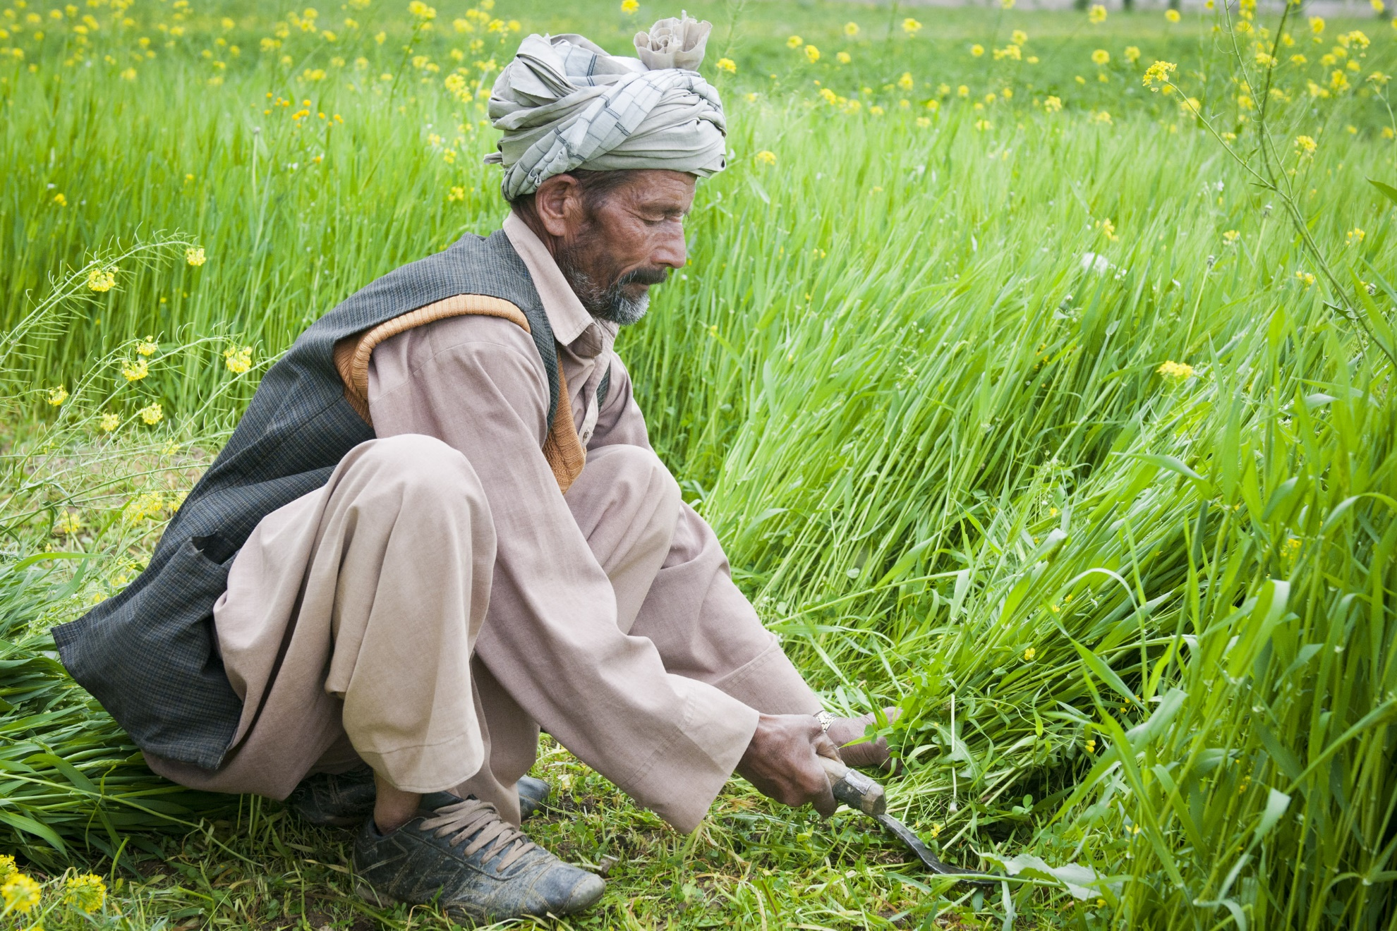
Objectives of the content
To introduce and to Understand the Historical Background of Agriculture in Bangladesh
Ancient and Medieval Periods (Before 1757)
Agriculture was mostly subsistence-based, relying on seasonal flooding and fertile soil. Rice, jute, and sugarcane were common, with farming supported by traditional irrigation systems.
Colonial Period (1757–1947)
The British introduced the Permanent Settlement, prioritizing cash crops like jute and indigo. This led to exploitation of farmers, food shortages, and a decline in food grain production.
Post-Colonial and East Pakistan Era (1947–1971)
Agriculture struggled with market disruption and poor policy support. Some modernization began through irrigation projects and research, but rural poverty and natural disasters remained major challenges.
Post-Independence Era (1971–Present)
Focus shifted to food security, irrigation, and high-yield crops. Modern farming techniques, NGO involvement, and climate-smart practices have boosted productivity and diversification.

Slide 4
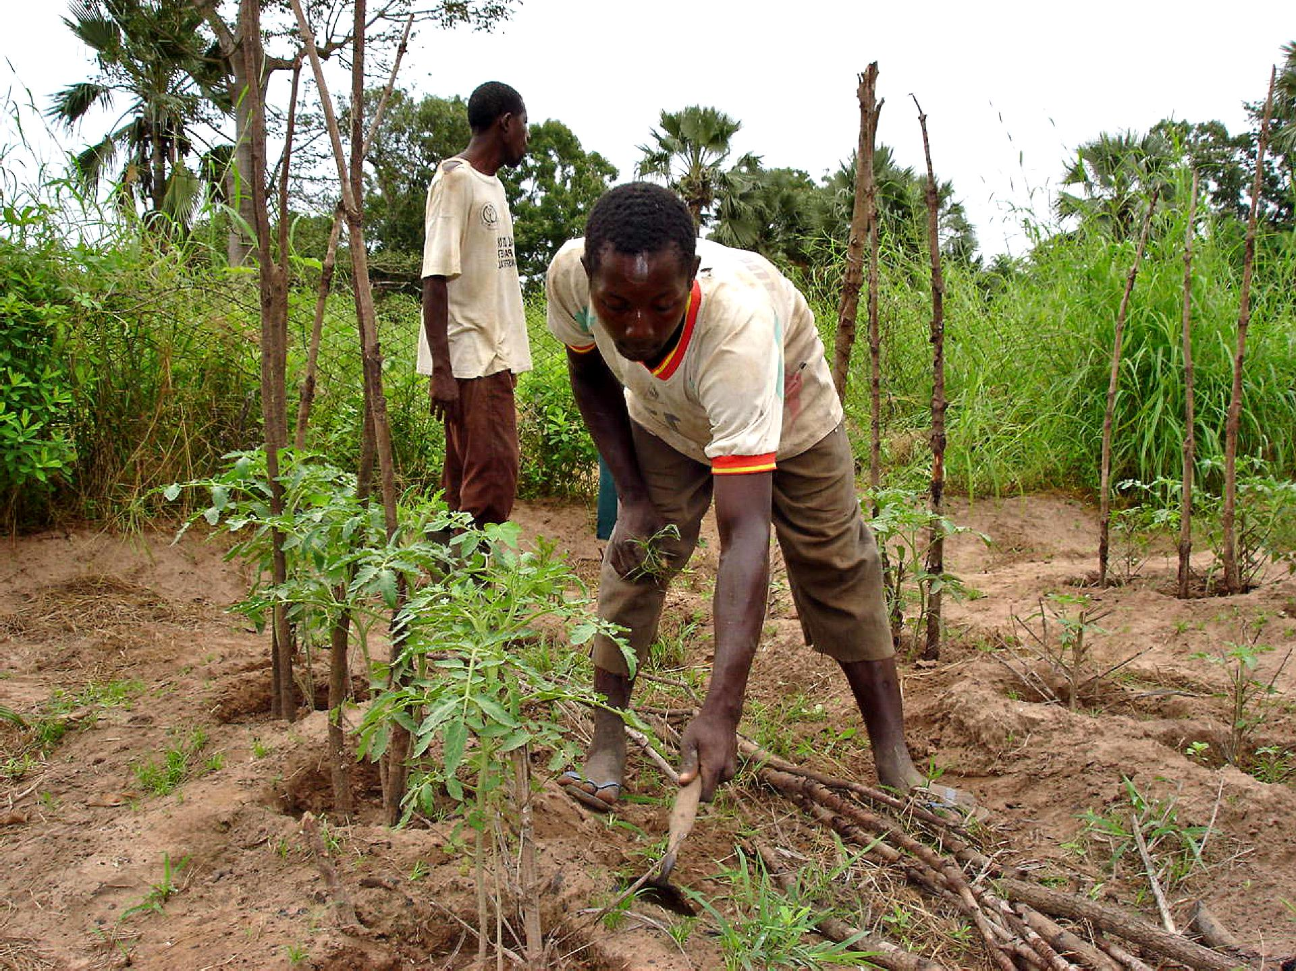
2. To understand the current scenario of agriculture in Bangladesh
Explore the present state of agricultural practices, production trends, and key contributors to the agricultural sector in Bangladesh.
Bangladesh has seen a rise in crop yields due to high-yielding varieties, irrigation, and fertilizer use. Assess the role of government policies, technological advancements, and socio-economic factors influencing agricultural growth.
Government subsidies, mobile agri-tech, and improved rural infrastructure support agricultural growth. NGOs and women’s participation have strengthened rural livelihoods and farm efficiency.
Identify the major crops, livestock, and farming techniques used in different regions of the country.
Major crops include rice, jute, maize, and vegetables, with poultry and aquaculture also key. Regional practices vary—north uses deep irrigation, south focuses on shrimp, and hills on fruits and mixed farming.

Slide 5
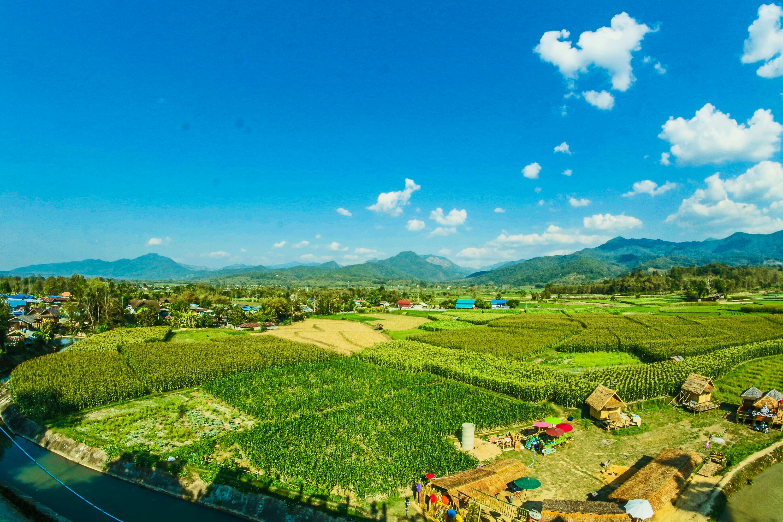
3. To understand the challenges of agriculture in Bangladesh
Analyze the key difficulties faced by farmers, including climate change, water scarcity, soil degradation, and natural disasters.
For example: Understanding the challenges of agriculture in Bangladesh involves examining the major issues farmers face, including climate change, water scarcity, soil degradation, and natural disasters. These environmental pressures are compounded by economic difficulties like limited access to credit, price instability, and market fluctuations. Additionally, poor infrastructure, weak policies, and slow adoption of modern technologies hinder agricultural progress.
Investigate economic challenges such as access to credit, market fluctuations, and price instability.
Examine policy-related barriers, infrastructural gaps, and issues in adopting modern agricultural technologies.

Slide 6
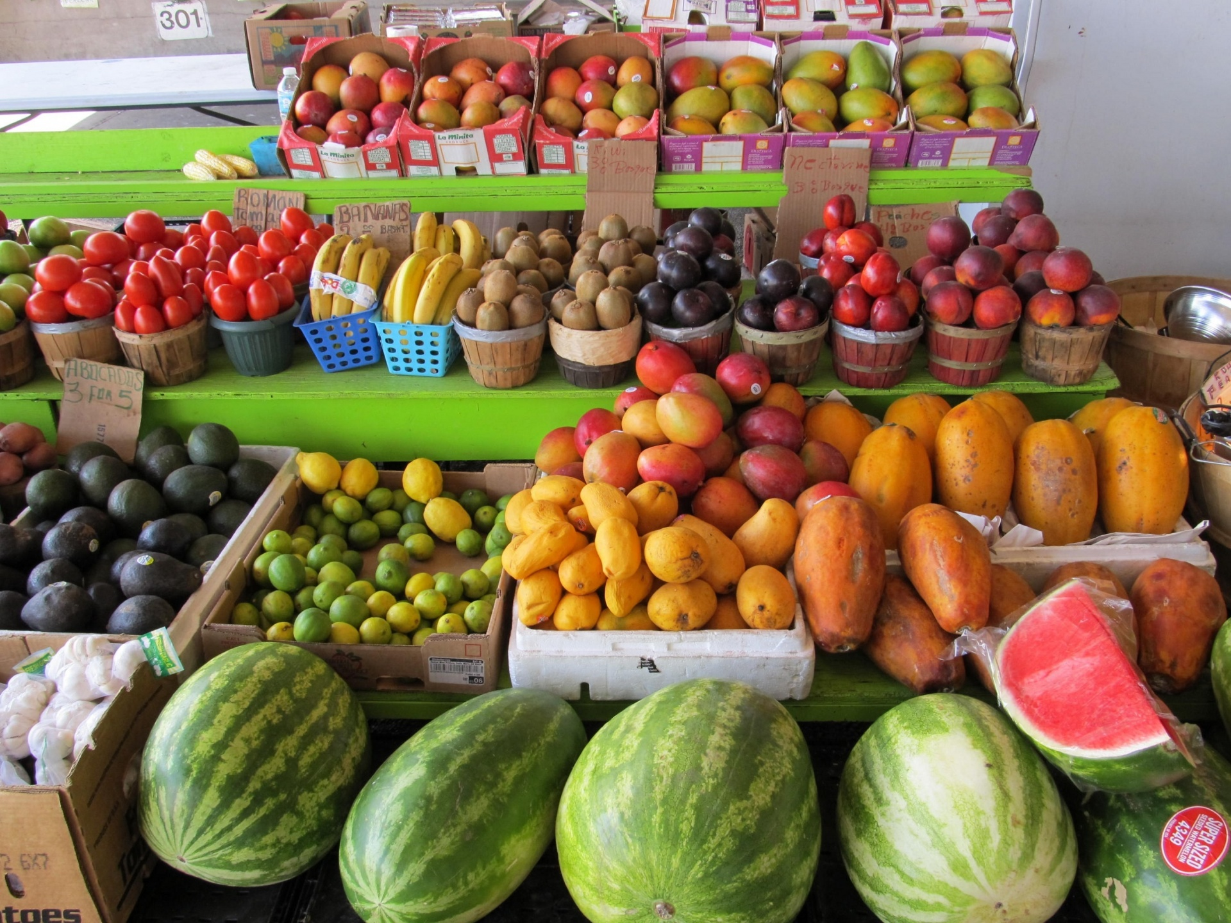
4. To understand interdisciplinary approaches in the agricultural sector in Bangladesh
Explore how different fields such as climate science, engineering, economics, and social sciences contribute to improving agricultural productivity.
Assess the impact of integrating technology, data analytics, and innovative farming techniques in addressing agricultural challenges.
Study the role of interdisciplinary collaborations between researchers, policymakers, and local farming communities in enhancing sustainable agricultural practices.
4

Slide 7
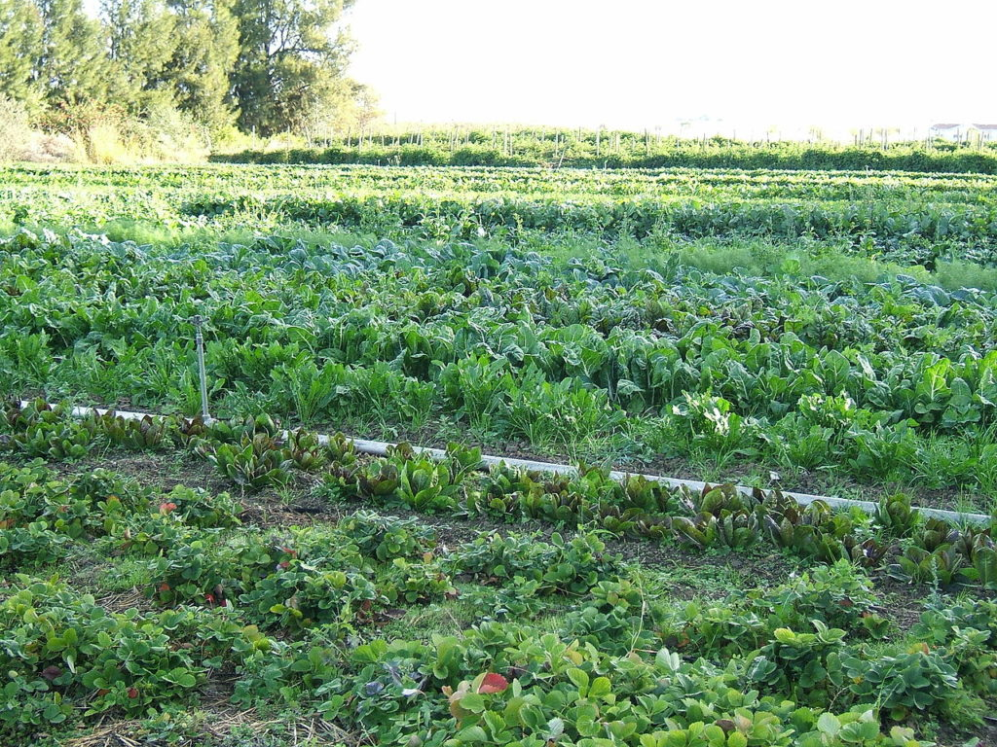
5. To understand Climate-Smart Agriculture in Bangladesh
To Understand Climate-Smart Agriculture in Bangladesh.
Equally important is the need to understand Climate-Smart Agriculture (CSA), which aims to help farmers adapt to climate change while improving productivity and sustainability. Exploring CSA includes identifying effective techniques and integrating knowledge from various fields to promote its use in Bangladesh’s agricultural practices.
To Explore Potential Aspects of Climate-Smart Agriculture (CSA)
To Assess How Knowledge from Different Disciplines Can Be Applied
to Promote Climate-Smart Agriculture (CSA)

Slide 8
Introduction to Agriculture of Bangladesh

Slide 9

What is Agriculture?
Agriculture is the practice of farming, involving the cultivation of crops and the raising of livestock to produce food and other essential products. It encompasses everything from planting seeds and tending animals to managing natural resources and bringing products to market. Agriculture is crucial for global food security, provides livelihoods for millions, drives economic development, and supplies raw materials for diverse industries. It's a foundational activity for human civilization.
www.youtube.com/watch?v=0hbhx_Jf3mc
Agriculture is the lifeblood of Bangladesh — a nation whose roots are deeply embedded in fertile soil. For generations, agriculture has not only been a means of survival but a way of life for the majority of Bangladeshis. From golden rice paddies to vibrant vegetable fields, agriculture feeds the people, supports families, and sustains livelihoods across the country. Beyond economic contribution, it helps preserve cultural traditions, rural values, and local knowledge systems passed down through generations. Agriculture contributes significantly to GDP and export earnings. As the country moves toward self-sufficiency in food production, agriculture has become a powerful force for national progress and rural development. With the right investment and innovation, agriculture continues to drive Bangladesh forward.

Slide 10
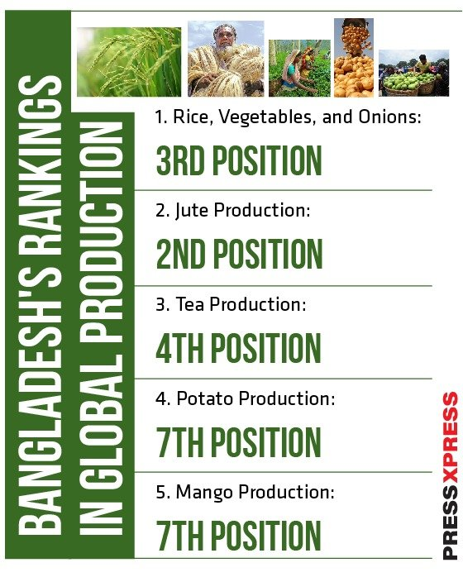
To understand the current scenario of agriculture in Bangladesh (Agricultural Sectors in Bangladesh in 2023)
Bangladesh Ranks Top 10 Globally in Agriculture
Source: https://pressxpress.org/2023/11/18/bangladesh-ranks-top-10-globally-in-agriculture/

Slide 11
Famous Personalities of Bangladesh and their contribution in Agriculture

Slide 12
Dr. Md. Rafiqul Islam Mondal
Former Director General of Bangladesh Agricultural Research Institute (BARI).
Played a major role in developing high-yield crop varieties, especially for vegetables, pulses, and oilseeds.
Contributed significantly to sustainable agriculture and food security.
Dr. M. A. Sattar Mandal
Renowned agricultural economist.
Former Vice Chancellor of Bangladesh Agricultural University (BAU).
Member of the Planning Commission, contributed to agricultural policy and rural development.
Dr. Md. Enamul Haque
Known for his work on sustainable farming systems and rural agricultural development.
Worked with both BARI and international development organizations.
Dr. Shirin Akhter
Vice-Chancellor of Begum Rokeya University; strong advocate for women’s participation in agricultural education and development.

Slide 13
Agriculture as the Main Livelihood for Millions in Bangladesh

Slide 14
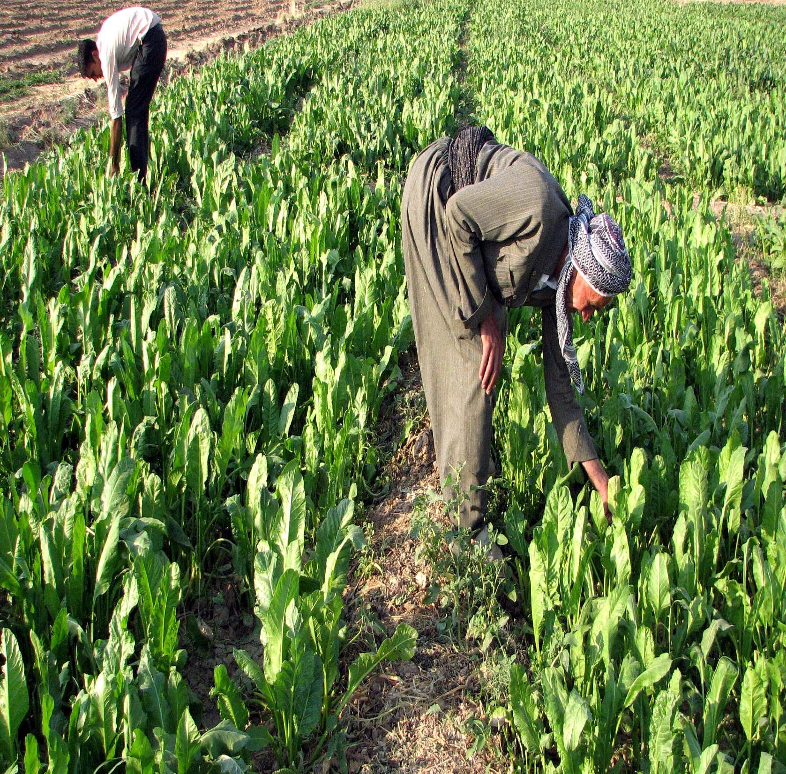
In Bangladesh, agriculture is not just an occupation—it is the primary source of livelihood for a large part of the population. Over 40% of Bangladesh’s people are directly involved in farming activities. This means that nearly half of the country’s workforce depends on agriculture for their income and survival.
These people include farmers, landless laborers, and women working in farm-related tasks. They grow staple crops like rice, vegetables, pulses, and fruits, which are essential for both local consumption and the country’s food supply.
Since Bangladesh is largely a rural country, many families rely on farming as their main economic activity. This direct involvement in agriculture supports not only food production but also rural employment. Without these millions of farmers, Bangladesh would face serious challenges in food security and economic stability. Therefore, farming remains the backbone of many livelihoods, highlighting the critical importance of agriculture to the nation’s well-being.

Slide 15
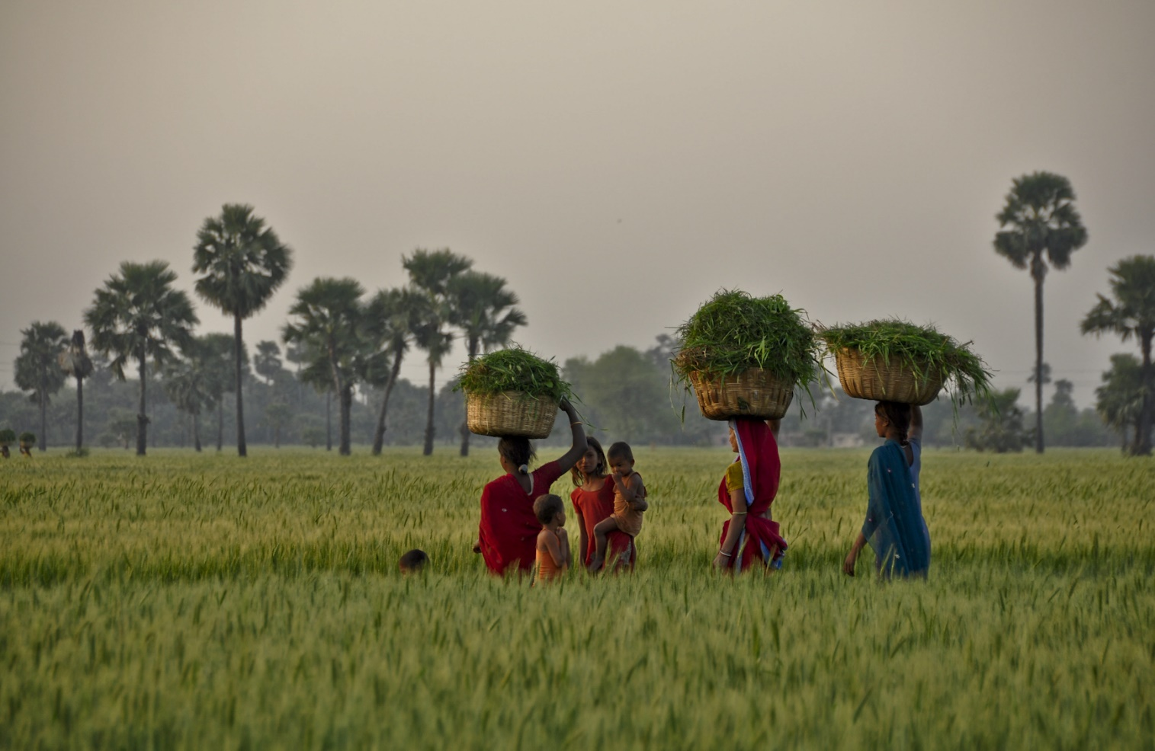
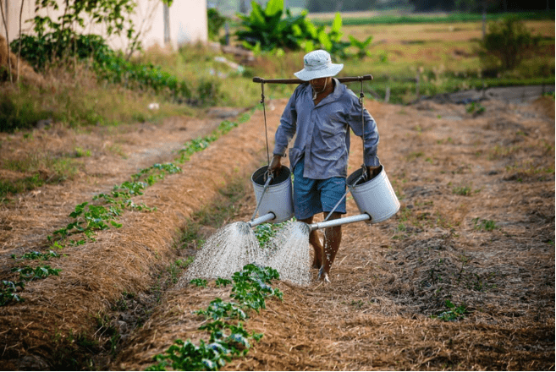
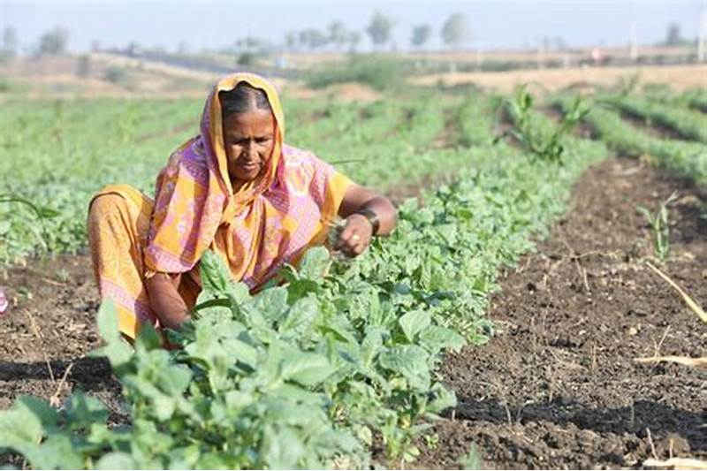
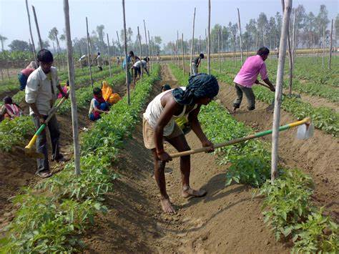
Agriculture is one of the most significant sources of employment, especially in developing countries like Bangladesh. It provides jobs not only to farmers but also to workers involved in irrigation, harvesting, livestock rearing, poultry, fisheries, and agro-based industries. These diverse sectors offer income opportunities to millions, especially in rural areas, helping to reduce poverty and improve livelihoods. Agriculture also plays a vital role in ensuring food security and supporting economic growth. With the advancement of technology and modern farming methods, new employment opportunities are emerging in agri-tech, organic farming, food processing, and agricultural research. Overall, agriculture is not just a way of life—it is a backbone of the economy and a powerful tool for sustainable development.

Slide 16
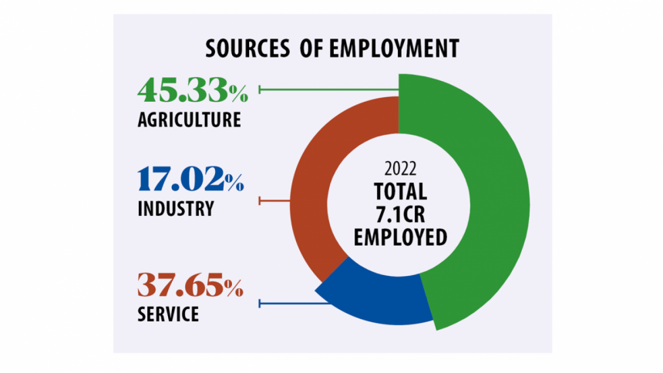
Bangladesh
Source: www.thedailystar.net/news/bangladesh/news/labour-force-survey-2022-agriculture-still-main-job-generator-3283936

Slide 18
Artificial Intelligence (AI) is transforming agriculture by making farming smarter, more efficient, and more sustainable. AI helps farmers make better decisions, reduce costs, and increase crop yields.
Smart Irrigation
AI systems use weather data and soil moisture sensors to decide when and how much water crops need.
This helps save water and avoid over- or under-irrigation.
AI-Based Crop Recommendation
AI systems suggest the most profitable and climate-suitable crops based on location, season, and market trends. It also supports better planning and income for farmers.

Slide 19
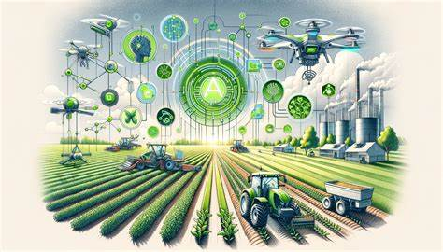
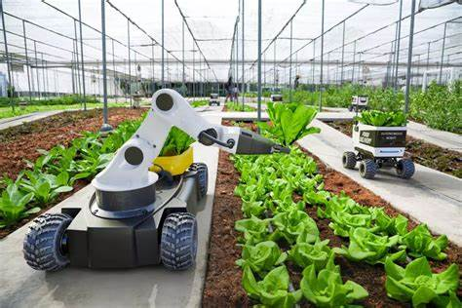
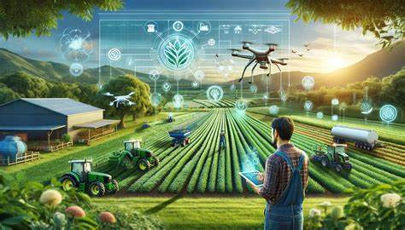
Crop Monitoring and Health Detection
AI-powered drones and satellite images help detect crop diseases, pests, and nutrient deficiencies. Machine learning models analyze plant images and give instant solutions.

Slide 20
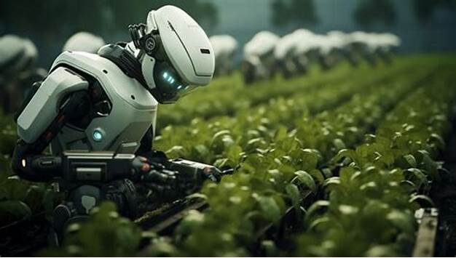

Drone and Satellite-Based Field Mapping
AI processes drone or satellite images to map fields, monitor growth, and detect problem areas.
AI Chatbots and Virtual
Assistants for Farmers
Farmers can use mobile-based AI
chatbots to get real-time farming advice in their local language.

Slide 21
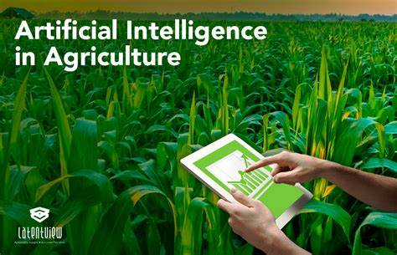

Slide 22
Role of Agriculture in GDP Growth of Bangladesh

Slide 23
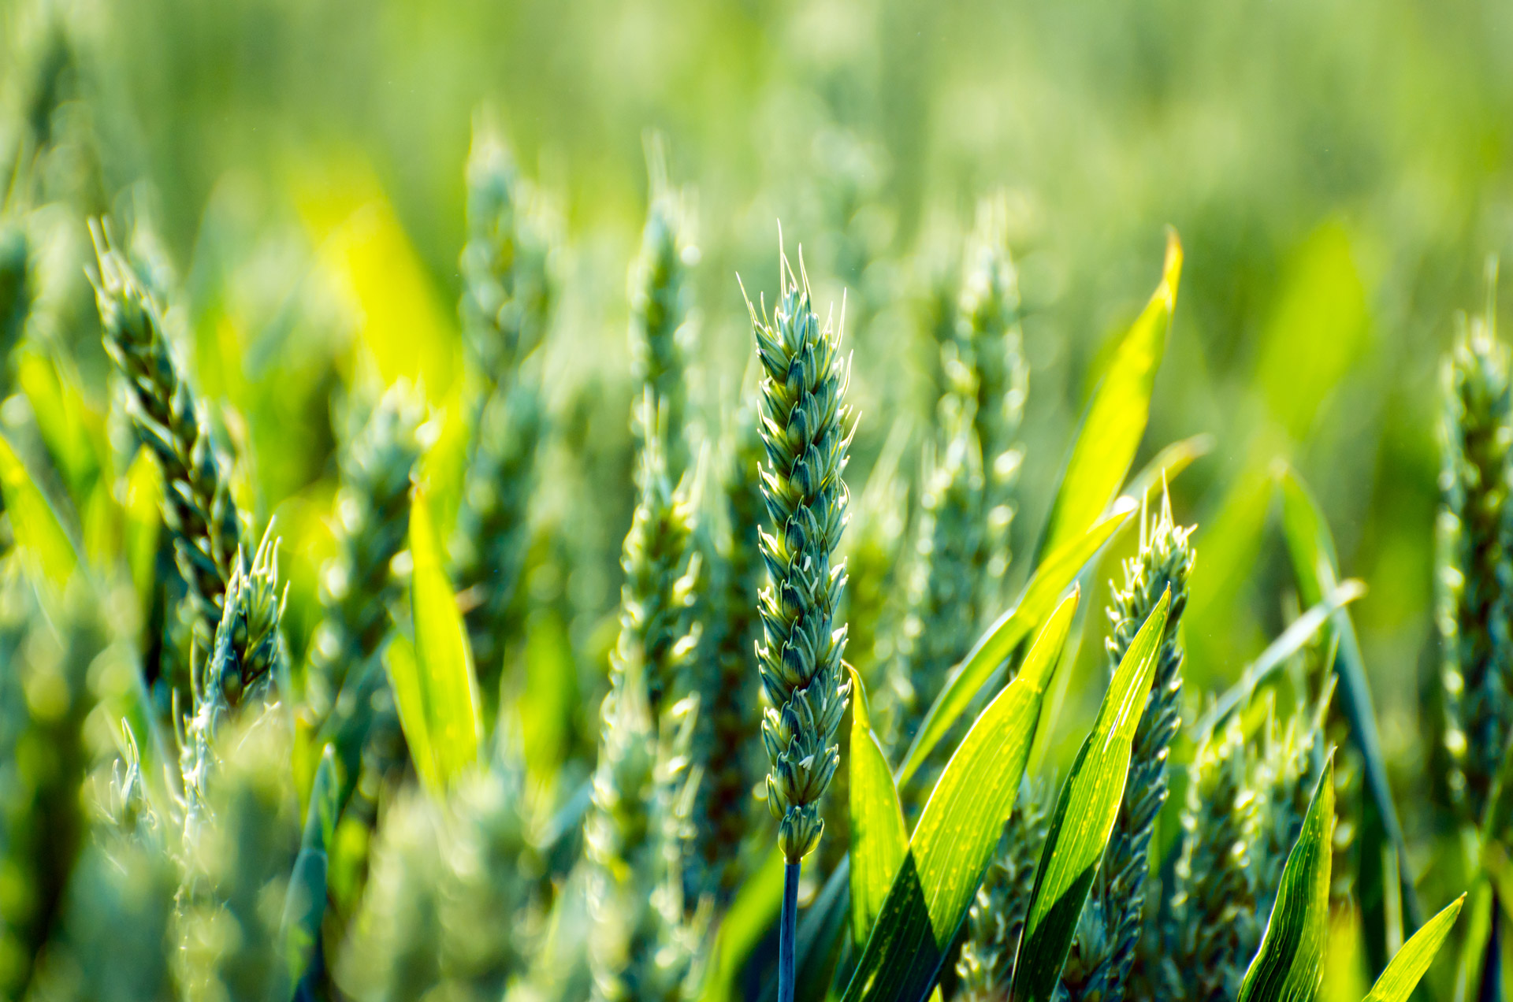
Agriculture plays a crucial role in the economy of Bangladesh by contributing a large portion to the country’s Gross Domestic Product (GDP). In Bangladesh, agriculture contributes around 13% to 15% of the GDP, making it a vital part of the national economy. This sector provides raw materials for many industries, such as food processing, textiles (like jute), and biofuels.
Moreover, agriculture supports other sectors like transportation, marketing, and manufacturing by generating demand for goods and services. The export of agricultural products such as jute, tea, vegetables, and seafood brings valuable foreign currency into the country, strengthening Bangladesh’s financial position internationally.
Therefore, a strong agricultural sector not only ensures food security but also drives economic growth, poverty reduction, and overall development in Bangladesh.

Slide 24
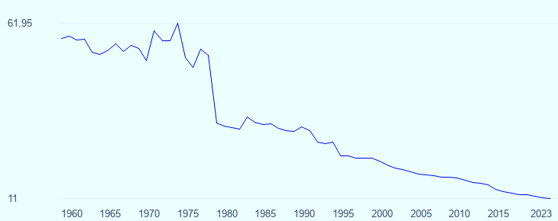

GDP Contribution of Agriculture in Bangladesh (1960–2023): Historical Series On the right side, there is a line graph showing the historical trend of agriculture's GDP contribution. The y-axis ranges from approximately 11 to 61.95, and the x-axis covers the years from 1960 to 2023. The line clearly shows a significant decline in the share of agriculture in Bangladesh's GDP over this period, with a sharp drop observed around the 1970s and a steady decline thereafter.

Slide 25
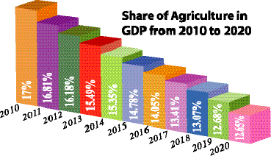
The bar chart shows the "Share of Agriculture in GDP from 2010 to 2020“ is mentioned here. The bars are arranged in descending order, indicating a continuous decrease in the agricultural share of GDP over this period .Here are the specific percentages for each year: 2010: 17% 2011: 16.81% 2012: 16.18% 2013: 15.49% 2014: 15.35% 2015: 14.78% 2016: 14.05% 2017: 13.41% 2018: 13.07% 2019: 12.68% 2020: 12.65%

Slide 26
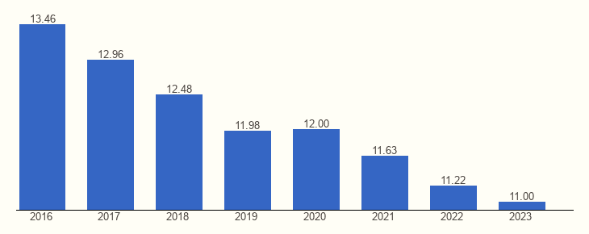
Gross Domestic Product (GDP)
Source: www.theglobaleconomy.com/Bangladesh/share_of_agriculture/
The graph shows the percentage share of agriculture in Bangladesh’s GDP from 2016 to 2023. In 2016, agriculture contributed 13.46% to the GDP, which was the highest in the given period. This percentage gradually declined over the years. In 2017, it dropped to 12.96%, and continued to fall to 12.48% in 2018, 11.98% in 2019, and then slightly rose to 12.00% in 2020. The slight increase in 2020 might be due to economic shifts during the COVID-19 pandemic. After that, the share declined again to 11.63% in 2021, 11.22% in 2022, and finally reached 11.00% in 2023, the lowest in the graph.
This trend indicates a steady decline in agriculture’s share of the national GDP.

Slide 27


Slide 28
1. Bangladesh’s agricultural history dates back thousands of years, with evidence of farming in the region during the Indus Valley Civilization.
3. During the Maurya (321–185 BCE) and Gupta (319–550 CE) empires, irrigation systems and improved farming methods were introduced, increasing food production.
4. The Mughal period (16th–18th century) saw significant agricultural expansion, with the introduction of new crops like potatoes, maize, and tobacco. Mughal rulers also promoted irrigation infrastructure and market-oriented agriculture
2. Early agricultural practices were primarily subsistence-based, with farmers cultivating rice, pulses, and oilseeds using simple tools and techniques.
Ancient and Medieval Periods (Before 1757)
Historical Background of Agriculture in Bangladesh

Slide 29
Colonial Period (1757–1947)
Under British rule, agriculture in Bengal was transformed due to land revenue policies and the shift toward cash crops like indigo, jute, and tea.
The Permanent Settlement Act of 1793 introduced the Zamindari system, which led to land exploitation, high taxation, and peasant distress.
While cash crops benefited British industries, food production suffered, leading to food shortages and devastating famines, such as the Bengal Famine of 1943, which caused millions of deaths.

Slide 30
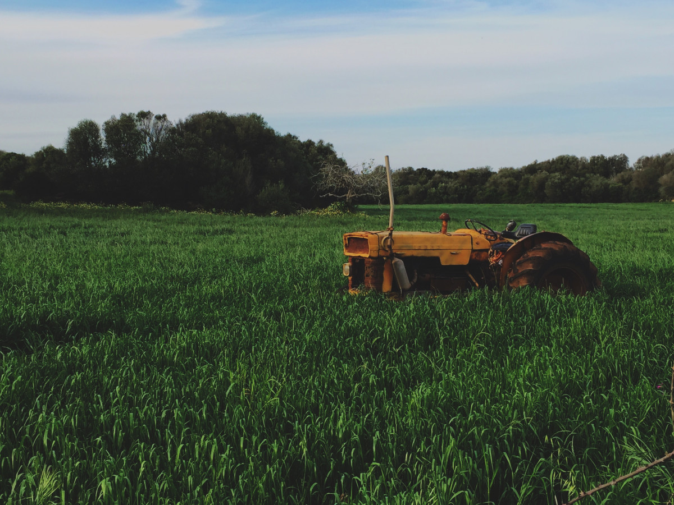
Post-Partition Period (1947)
After the partition of India in 1947, Bangladesh became East Pakistan, and agriculture remained the backbone of the economy. Most people were dependent on farming for their livelihood.
Green Revolution (1960s)
The Green Revolution of the 1960s introduced high-yielding variety (HYV) seeds, chemical fertilizers, and mechanization, increasing food production. It marked a turning point by improving food security, though access was not equal for all farmers.
Despite these advancements, farmers faced challenges such as lack of access to modern technology, unequal land distribution, and frequent natural disasters like floods and cyclones.
Post-Colonial and East Pakistan Era (1947–1971)

Slide 31
Post-Independence Era (1971–Present)
After independence in 1971, Bangladesh faced severe food shortages due to war destruction and natural calamities.
Government initiatives, international aid, and agricultural research helped modernize farming through irrigation expansion, hybrid seeds, and rural electrification.
In recent decades, climate-smart agriculture, organic farming, and digital technology have played a crucial role in improving productivity and food security.

Slide 32
Challenges of Agriculture in Bangladesh

Slide 33
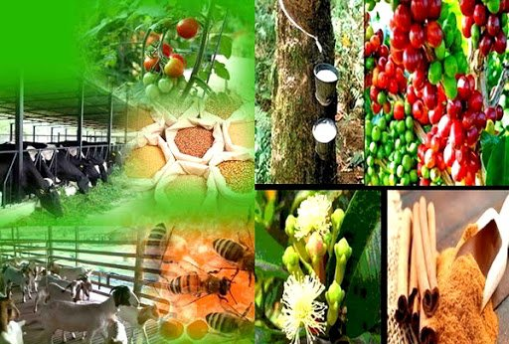

Slide 34
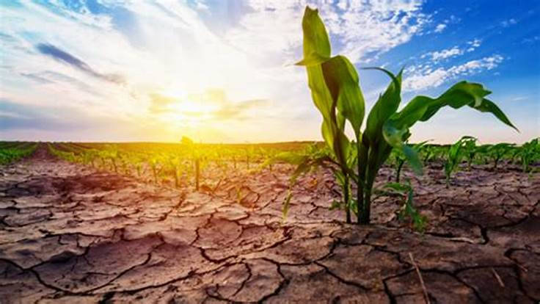
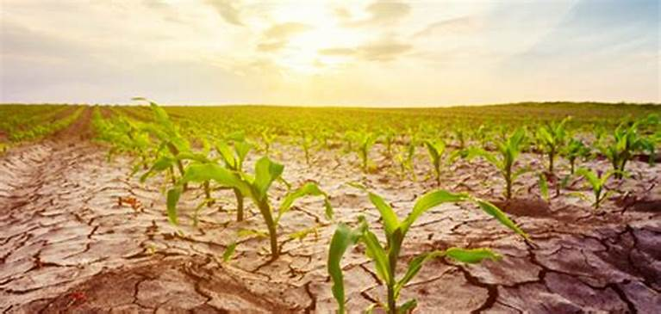
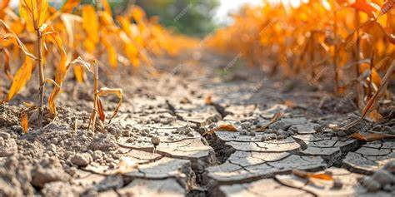
1. Land Scarcity and Fragmentation
One of the most critical issue is the decreasing availability of arable land. With a growing population and rapid urbanization, agricultural land is continuously being converted into residential and industrial areas. Additionally, land fragmentation due to inheritance customs leads to small, scattered plots that are difficult to cultivate efficiently. This fragmentation not only reduces productivity but also discourages investment in modern agricultural technologies.

Slide 35
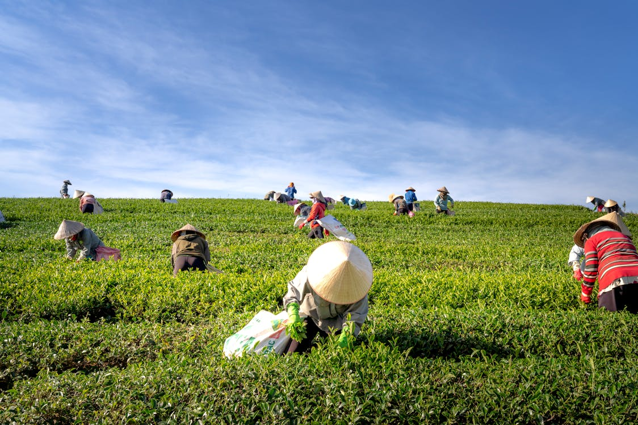
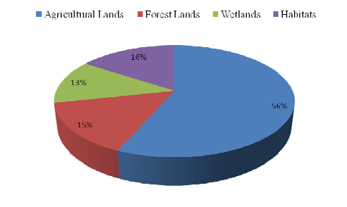
Arable land (% of land area) - Bangladesh
Source: www.researchgate.net/figure/The-total-available-land-area-of-Bangladesh-can-be-divided-into-4-distinct-categories_fig1_228865571

Slide 36
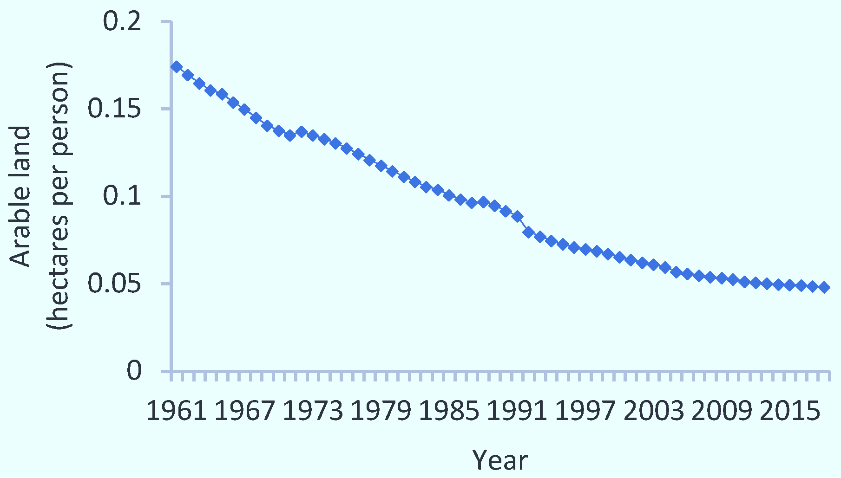
Figure 1. Declining per person arable land, Bangladesh
The graph illustrates the global trend of arable land per person from 1961 to 2015. Arable land refers to land suitable for growing crops. Over the 54-year period, there is a clear and steady decline in the amount of arable land available to each individual worldwide. In 1961, the value was just below 0.20 hectares per person. As time progresses, the graph shows a continuous downward slope, indicating that the per capita availability of arable land has been shrinking. After that, the rate of decline becomes more gradual but still consistent, reaching less than 0.05 hectares per person by 2015. With more people sharing a relatively fixed amount of cultivable land, the average amount of land available per person has decreased significantly. This poses challenges for food production, resource management, and sustainable development.
Source: www.mdpi.com/1996-1073/15/11/4037

Slide 37
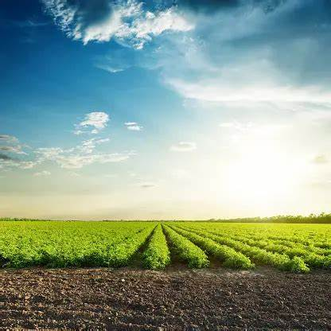
Arable land (in hectares) includes land defined by the FAO as land under temporary crops (double-cropped areas are counted once), temporary meadows for mowing or for pasture, land under market or kitchen gardens, and land temporarily fallow. Land abandoned as a result of shifting cultivation is excluded. Bangladesh arable land for 2021 was 8,110,000, a 1.37% increase from 2020.
Bangladesh arable land for 2020 was 8,000,000, a 0.41% increase from 2019.
Bangladesh arable land for 2019 was 7,967,000, a 2.51% increase from 2018.
Bangladesh arable land for 2018 was 7,772,300, a 0.19% increase from 2017.
Source: www.macrotrends.net/global-metrics/countries/bgd/bangladesh/arable-land#:~:text=Bangladesh%20arable%20land%20for%202021,a%202.51%25%20increase%20from%202018.

Slide 38
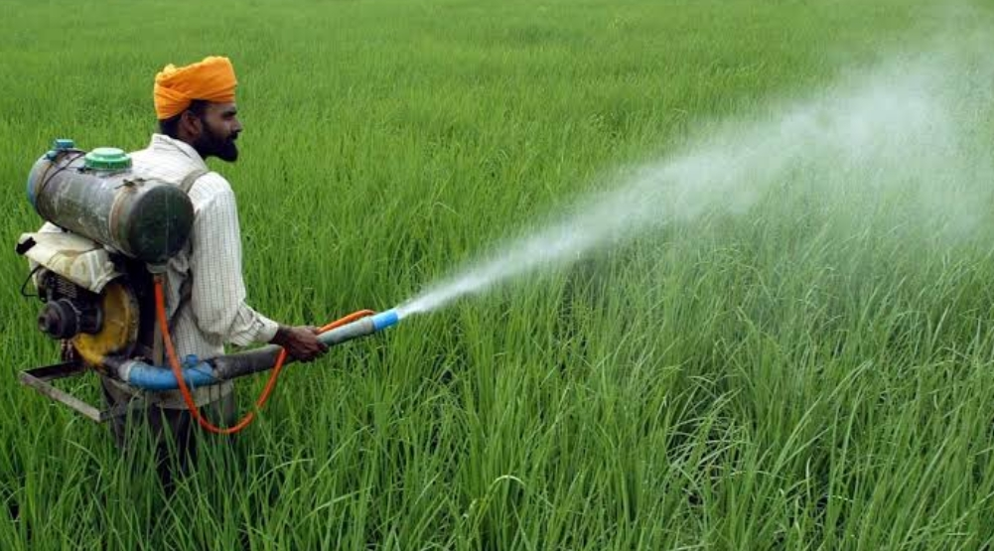
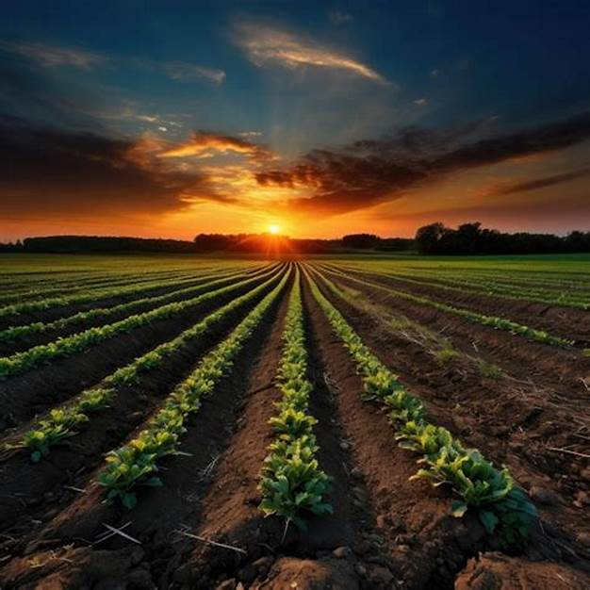
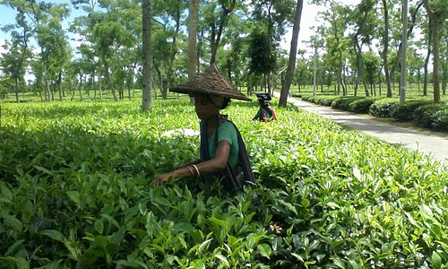

2. Climate Change and Environmental Vulnerability
Bangladesh is one of the most climate-vulnerable countries in the world, and its agriculture sector is highly susceptible to environmental challenges, including:
Flooding and River Erosion: Recurring floods damage crops, destroy farmland, and displace farmers.
Cyclones and Storm Surges: Coastal agriculture is frequently affected by cyclones, leading to salinity intrusion in farmland.
Droughts and Water Scarcity: Northern and western Bangladesh face drought conditions that limit irrigation and crop production.
Rising Temperatures: Heat stress affects crop yields, especially for staple crops like rice and wheat.
Academic Perspective: Research highlights that adaptation strategies such as improved irrigation, stress-tolerant crop varieties, and climate-smart agricultural practices are critical to mitigating these impacts (Rahman et al., 2022).

Slide 39
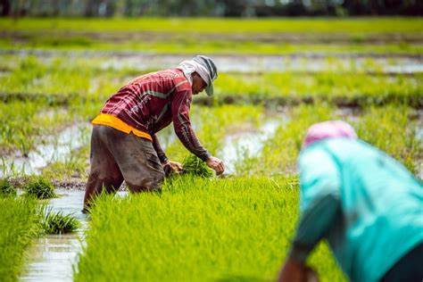

Slide 40
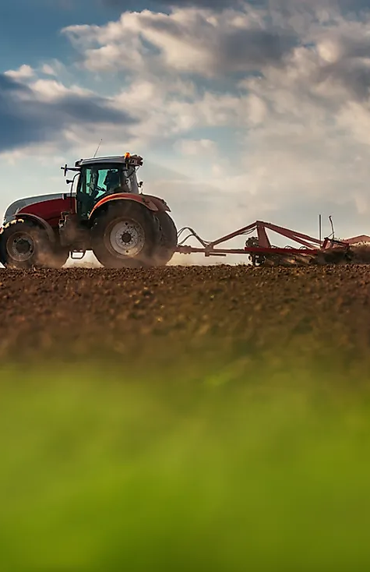
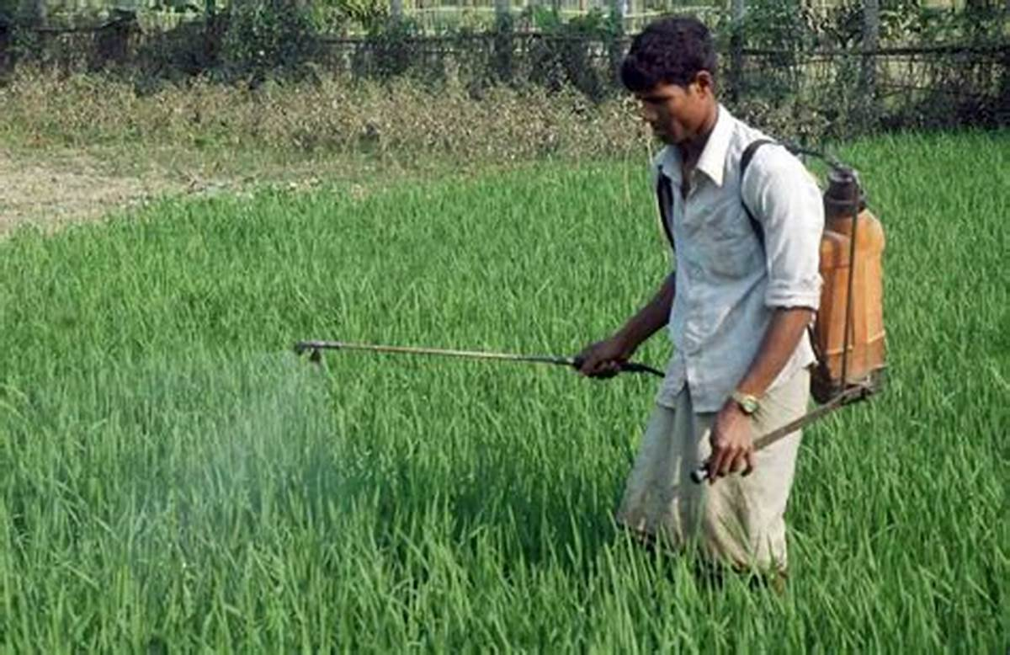
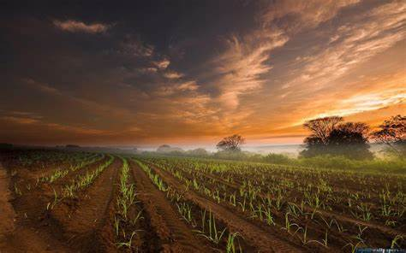
3. Soil Fertility Decline
Soil Salinity: Coastal areas suffer from increased salinity due to rising sea levels and shrimp farming.
Soil Erosion: Intensive farming and deforestation lead to loss of fertile topsoil.
Overuse of Chemical Fertilizers and Pesticides: Excessive reliance on agrochemicals has led to soil degradation and declining soil health.
Academic Perspective: Sustainable land management practices, including crop rotation, organic fertilizers, and agroforestry, are being recommended to counteract soil degradation (Hossain & Haque, 2021).

Slide 41
4. Small Landholding and Fragmentation
Most farmers in Bangladesh operate on small plots, often less than one hectare.
Land fragmentation reduces productivity and makes mechanization difficult.
Farmers lack access to financial resources to consolidate land or invest in modern technologies.
Academic Perspective: Land tenure reforms, cooperative farming models, and land consolidation programs have been proposed as potential solutions (Islam et al., 2020).

Slide 42
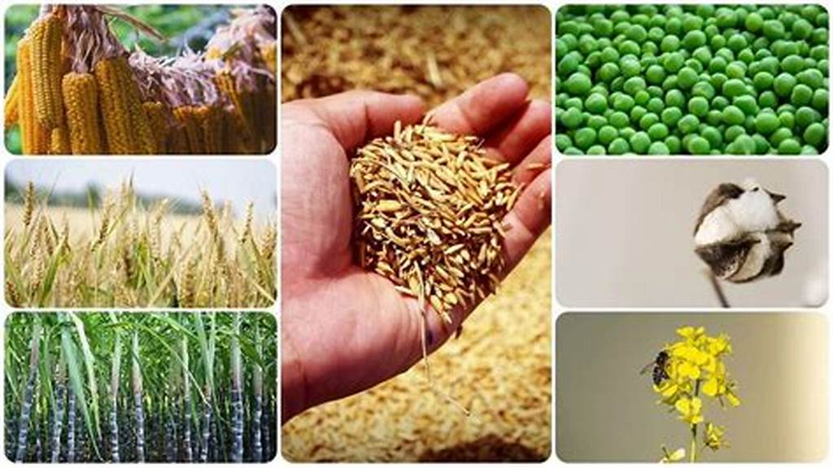
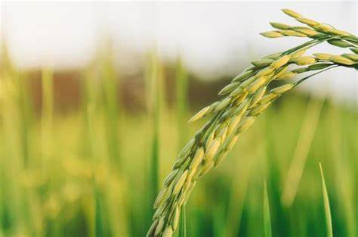
5. Water Management Challenges
Dependence on monsoon rains leads to water supply variability.
Irrigation Inefficiency: Groundwater depletion due to excessive irrigation for rice cultivation.
Arsenic Contamination: High levels of arsenic in groundwater pose risks to crops and human health.
Academic Perspective: Improved irrigation techniques, such as drip and sprinkler systems, and better groundwater management policies are necessary for sustainable water use (Ahmed et al., 2023).

Slide 43
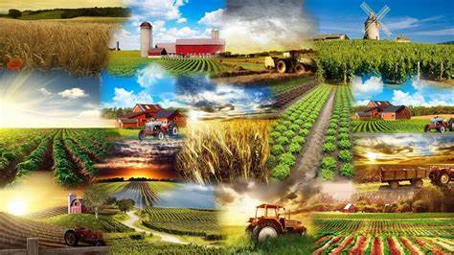
Agriculture in Bangladesh today faces serious water and environmental issues. Because it depends so heavily on seasonal rains, water availability can be unpredictable. The overuse of groundwater for growing rice has also caused water levels to drop. On top of that, many areas suffer from arsenic contamination in groundwater, which is harmful to both crops and human health. Experts suggest adopting more efficient irrigation methods, like drip and sprinkler systems, along with better management of water resources. Bangladesh is also one of the countries most at risk from climate change. Rising sea levels, increased soil salinity, erratic monsoons, and more frequent floods and droughts are all affecting farming. Since agriculture makes up about 13% of the country’s GDP and employs over 40% of the population, adopting climate-smart farming practices is essential to protect both livelihoods and food production
Water and Climate Challenges in Bangladeshi Agriculture

Slide 44
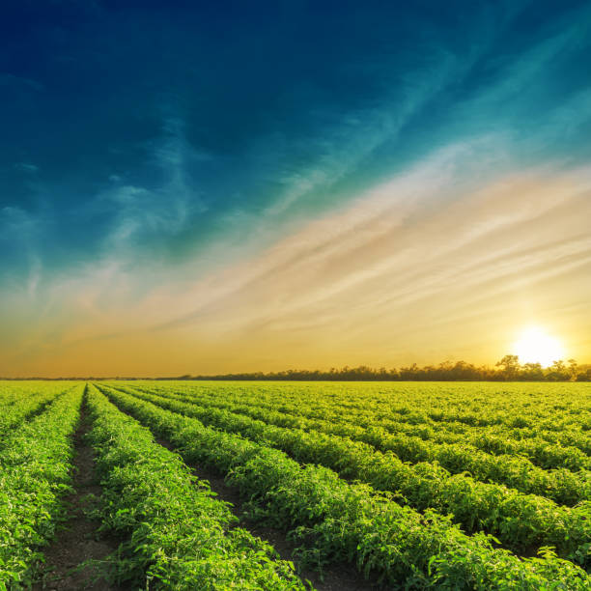
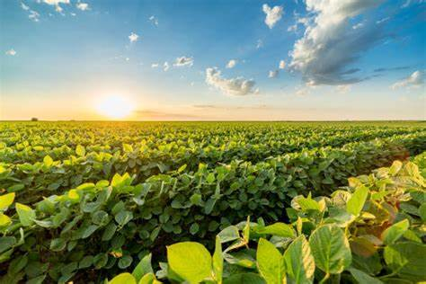
6. Lack of Access to Modern Technology and Innovation
Dependence on Traditional Methods
Many farmers still rely on traditional farming methods, leading to lower productivity. While these methods are sustainable, they usually result in lower yields and slower production
Limited Mechanization
Limited adoption of mechanized farming tools due to high costs. Modern equipment like tractors and threshers are expensive and unaffordable for many small farmers. This creates a gap between large landowners and smallholders, limiting the latter’s productivity.
Weak Agricultural Extension Services
Lack of agricultural research and extension services to disseminate modern farming techniques.
Academic Perspective: Strengthening agricultural extension services and promoting precision agriculture could enhance productivity (Rahman & Sarker, 2021).
Poor Access to Innovation
Technological advancements are slow to reach rural areas due to poor infrastructure and low investment.Even when innovations exist, they often don’t get adopted because of limited access and awareness.

Slide 45
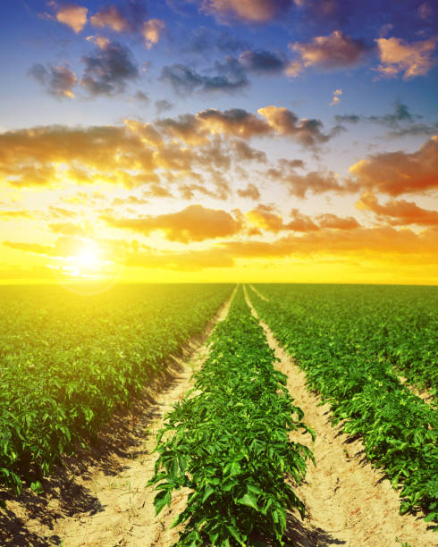
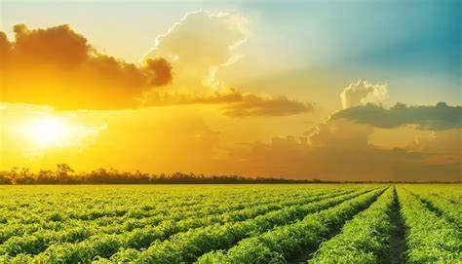
7. Market Access and Price Volatility
Farmers often struggle with poor access to markets, leading to post-harvest losses.
Middlemen dominate the supply chain, reducing farmers’ profit margins.Fluctuations in global commodity prices affect local markets.
Academic Perspective: The development of rural infrastructure, digital marketplaces, and cooperative models could improve market access and price stability (Karim et al., 2022).

Slide 46
8. Food Security and Nutrition Concerns
Bangladesh has made progress in food production, but malnutrition remains a challenge.
Heavy reliance on rice cultivation limits dietary diversity.
Lack of access to protein-rich foods contributes to malnutrition. Though people have enough rice to eat, their diets lack essential vitamins, minerals and proteins. About 24% of children under 5 suffer from stunted growth due to chronic malnutrition. The over-reliance on rice (providing 70% of daily calories. Most families can't afford or access diverse foods like vegetables, fruits, fish or eggs regularly. Seasonal food shortages in disaster-prone areas worsen the situation. Solutions require moving beyond just increasing rice yields to promoting kitchen gardens, small-scale poultry farming, and community nutrition programs alongside traditional agriculture
Academic Perspective: Diversification into high-value crops, fisheries, and livestock farming is recommended for improving food security and nutrition (Chowdhury et al., 2021).

Slide 47
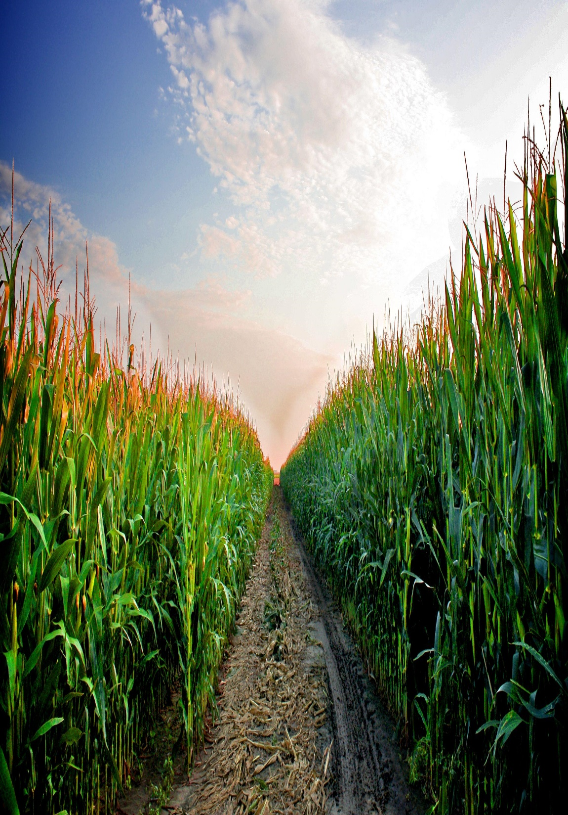
9. Policy and Institutional Constraints
Agricultural development in many developing countries, including Bangladesh, faces significant challenges due to policy and institutional constraints.
Inconsistent agricultural policies and lack of long-term planning.
One of the most pressing issues is the inconsistency of agricultural policies and the lack of long-term planning. These inconsistencies often stem from frequent policy shifts with changes in government, leading to uncertainty among farmers and investors. As a result, farmers find it difficult to make informed decisions about crop selection, investment in technology, or long-term land use, which ultimately hampers productivity and rural development.
Weak enforcement of environmental regulations.
Another critical issue is the weak enforcement of environmental regulations. Although there are existing laws aimed at protecting natural resources and ensuring sustainable farming practices, the lack of implementation and monitoring leads to practices such as overuse of chemical fertilizers, deforestation, and unregulated irrigation. These activities degrade soil quality and water resources, further threatening the long-term sustainability of agriculture.
Limited financial support for smallholder farmers.
Academic Perspective: Strengthening agricultural policies, ensuring farmer-friendly subsidies, and improving institutional coordination are essential for sustainable agricultural development (Uddin & Hossain, 2023).

Slide 48
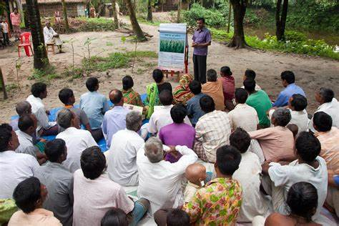
A significant portion of the farming community lacks formal education and proper training in modern agricultural practices. As a result, they are unaware of crop rotation, pest control techniques, climate-resilient crops, and sustainable farming. This knowledge gap leads to inefficient practices and environmental degradation. Strengthening agricultural extension services is crucial to address this issue.
.
10. Education and Training Deficiencies

Slide 49
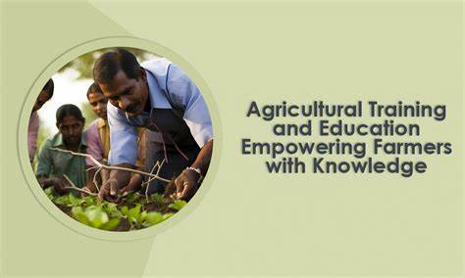

Slide 50
To understand interdisciplinary approaches in the agricultural sector in Bangladesh

Slide 51
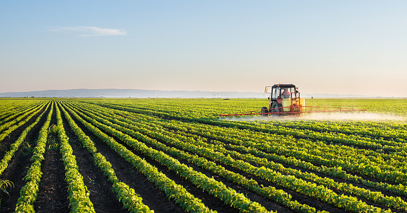
Framing the Problem: Why Interdisciplinary?
Agricultural productivity in Bangladesh is hindered by:
Erratic weather patterns (e.g., floods, droughts)
Limited access to quality inputs and infrastructure
Market instability and rural poverty
Agricultural productivity in Bangladesh faces complex, interrelated challenges that cannot be addressed by a single discipline. Climate change significantly disrupts agriculture, causing erratic weather events such as floods, droughts, and cyclones. These events reduce crop yields and food availability. Furthermore, farmers often lack access to quality seeds, fertilizers, irrigation, and transportation, limiting their ability to respond effectively. Market instability, price volatility, and rural poverty worsen the situation, making agriculture less profitable and more risky. Rahman emphasizes that tackling these challenges requires interdisciplinary approaches that integrate climate science, economics, agronomy, and social development to create sustainable and resilient agricultural systems.
📚 Rahman, Sanzidur. 2019. “Climate Change, Agriculture and Food Security in Bangladesh: An Overview.” Sustainability 11(6):1611.

Slide 52
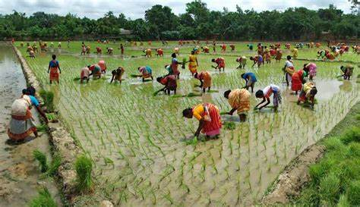
What Is an Interdisciplinary Approach? Definition: Combining two or more academic disciplines to solve complex problems. In agriculture: Integrating insights from climate science, engineering, economics, and social sciences to create sustainable farming solutions. 📚 Biggs, Stephen D. 2008. “Learning from the Positive to Reduce Rural Poverty and Increase Social Justice: Institutional Innovations in Agriculture and Natural Resource Management.” Experimental Agriculture 44(1):37–60.

Slide 53

Example 1: Climate Science & Agriculture:
Climate models inform seasonal crop calendars and risk mapping.
Example: The Bangladesh Meteorological Department collaborates with IRRI to develop rice varieties resilient to heat and floods.
📚 Lobell, David B., and Marshall B. Burke. 2010. “On the Use of Statistical Models to Predict Crop Yield Responses to Climate Change.” Agricultural and Forest Meteorology 150(11):1443–1452.

Slide 54


Slide 55
Example 2: Engineering & Technology Engineers develop:
Solar-powered irrigation pumpsLow-cost greenhouses
Example: BRRI’s mechanized rice transplanting machine reduces labor needs by 50%.
📚 Hossain, Md. Alamgir, et al. 2021. “Adoption of Mechanized Rice Transplanting in Bangladesh.” Agricultural Systems 188:103034.

Slide 56

Example 3: Economics & Markets
Economists:
Model input-output systemsAnalyze subsidy impacts Economists analyze how inputs like seeds, water, and labor relate to outputs like crop yields and profits. This helps optimize farm productivity and economic planning.
Evaluate profitability of crop diversification Economists assess if growing different crops instead of just one improves income and reduces risk for farmers.
Example: “Farm Economics Lab” at BARC evaluates cost-benefit of high-value crops like capsicum and strawberries.
📚 Hossain, Mahabub. 2015. “Sustainable Agricultural Development in Bangladesh: Challenges and Policy Options.” Bangladesh Development Studies 38(4):95–112.

Slide 57

Example 4: Social Sciences & Communities
Anthropologists and sociologists assess:
Indigenous knowledge systems
Researchers study traditional farming methods and wisdom to see how they contribute to sustainable agriculture.
Gender roles in farming They analyze how men and women participate in farming activities to address inequality and improve productivity.
Farmer adoption behavior Social scientists explore why and how farmers accept or reject new technologies and practices.
Example: Participatory research in Rangpur shows local knowledge improves adoption of pest management practices.
📚 Chambers, Robert. 1994. “Participatory Rural Appraisal (PRA): Analysis of Experience.” World Development 22(9):1253–1268.

Slide 58


Slide 59



To understand Climate-Smart Agriculture in Bangladesh
Climate-Smart Agriculture (CSA) is an integrated approach to managing landscapes—cropland, livestock, forests, and fisheries—that aims to:
Increase agricultural productivity and incomes. It helps farmers grow more and earn more, even in challenging conditions.
Enhance resilience and adaptation to climate change CSA uses methods that prepare farms to handle floods, droughts, heat, and other climate challenges.
Reduce and/or remove greenhouse gas emissions. It includes eco-friendly practices that cut down pollution from farming (like methane and CO₂).
📚 FAO. 2013. “Climate-Smart Agriculture Sourcebook.” Rome: Food and Agriculture Organization.

Slide 60



Slide 61
Why CSA in Bangladesh?

Slide 62



Bangladesh is one of the most climate-vulnerable countries in the world due to:
Rising sea levels
Salinity intrusion
Irregular monsoons
Increased frequency of floods and droughts
Agriculture accounts for ~13% of GDP and employs 40%+ of the workforce.
Bangladesh ranks among the most climate-vulnerable nations globally, facing critical threats that directly affect its agricultural sector. Rising sea levels and salinity intrusion threaten coastal farming, reducing soil fertility and crop diversity. Irregular monsoons and unpredictable rainfall patterns disrupt planting and harvesting cycles, while the increased frequency of floods and droughts causes extensive crop loss and food insecurity. Given that agriculture contributes about 13% to the national GDP and employs over 40% of the workforce, these challenges have far-reaching economic and social impacts. Raihan et al. (2019) argue that adopting Climate-Smart Agriculture (CSA) is essential for enhancing resilience, improving productivity, and ensuring food security under changing climatic conditions.
📚 Raihan, S., et al. 2019. “Climate Change, Agriculture and Food Security in Bangladesh.” Bangladesh Journal of Agricultural Economics 42(1):15–32.

Slide 63



1. Technological Innovations
Objective: Increase yield while minimizing resource use and GHG emissions
Examples: Stress-tolerant crop varieties (e.g., drought- or salinity-tolerant rice)
Alternate Wetting and Drying (AWD) for rice fields — reduces methane emissions
Solar-powered irrigation systems in water-scarce areas
Remote sensing & GIS for precision agriculture
📚 Aryal, J. P., et al. 2020. “Technological Interventions and Climate-Smart Agriculture in South Asia.” Environmental Development 33:100502.

Slide 64


2. Data, ICT, and Climate Services
Objective: Deliver actionable information to farmers and planners
Examples:
Agromet advisories sent via SMS or mobile apps
Digital dashboards for crop-climate modeling
Early warning systems for floods or pests
To build climate resilience in agriculture, it is essential to equip farmers and planners with timely, relevant, and location-specific information. The objective is to transform raw climate and agricultural data into actionable insights that guide decisions on planting, harvesting, and risk management. The integration of digital tools can bridge the gap between science and field-level action. For example, agrometeorological advisories delivered via SMS or mobile apps help farmers adapt to changing weather. Crop-climate models, visualized through digital dashboards, support agricultural planning and policy-making. Early warning systems for floods, droughts, or pest outbreaks enable preventive action, reducing crop losses and improving food security.
📚 Zougmoré, R., et al. 2016. “Science-Policy Interfaces for CSA in West Africa.” Frontiers in Climate 4:45.

Slide 65




3. Behavioral and Cultural Adaptation
Objective:
Tailor CSA practices to local knowledge, beliefs, and behaviors
Examples:
Using ethnographic research to understand farmer perceptions
Respecting and incorporating indigenous climate indicators
Adopting Climate-Smart Agriculture (CSA) is not just a technical challenge—it also requires understanding and aligning with local knowledge systems, cultural beliefs, and behavioral patterns. Ethnographic and participatory approaches are essential to ensure that climate information and technologies are relevant and accepted at the community level. In Bangladesh, especially in the southwest, integrating indigenous climate indicators—such as traditional signs of rainfall or seasonal shifts—helps farmers relate to and trust new practices. Ethnographic research reveals how farmers perceive risks and make decisions, which is crucial for tailoring CSA interventions. Moreover, developing community-based adaptation plans encourages local ownership, strengthens trust, and increases long-term adoption of CSA strategies.
(https://bigd.bracu.ac.bd/publications/exploring-ways-of-promoting-climate-adaptive-technology-in-agriculture-in-south-west-region-of-bangladesh/)
Designing community-based adaptation plans
📚 Roncoli, Carla. 2006. “Ethnographic and Participatory Approaches to Climate Information Use.” Climate Research 33:81–99.

Slide 66

CONCLUSION
Agriculture remains a cornerstone of Bangladesh’s economy, society, and food security. Despite remarkable progress in production and innovation, the sector faces challenges ranging from climate change and land scarcity to poor infrastructure and market instability. Addressing these issues requires a multidimensional and inclusive approach that combines technological innovation, climate-smart practices, policy reform, and community engagement. By embracing interdisciplinary solutions and respecting local knowledge, Bangladesh can build a more resilient, productive, and sustainable agricultural system that supports its people and contributes to national development.

Slide 67
References
Bose, S., & Jalal, A. (2017). Modern South Asia: History, Culture, Political Economy (4th ed.).
Alauddin, M., & Tisdell, C. A. (1991). The Green Revolution and Economic Development: The Process and Its Impact in Bangladesh.
Roncoli, C. (2006). Ethnographic and participatory approaches to climate information use. Climate Research, 33, 81–99.
BRAC University. Exploring ways of promoting climate adaptive technology in agriculture in South-West region of Bangladesh. BRAC Institute of Governance and Development (BIGD). https://bigd.bracu.ac.bd/publications/exploring-ways-of-promoting-climate-adaptive-technology-in-agriculture-in-south-west-region-of-bangladesh/
Ahmed, M. (2023). Water use efficiency and groundwater management in Bangladesh. Journal of Agricultural Sustainability.
Alam, M. S. (1994). Agricultural history of Bangladesh. University Press Limited.
Bangladesh Bureau of Statistics. (2022). Statistical yearbook of Bangladesh. Government of the People’s Republic of Bangladesh.
Eaton, R. M. (1993). The rise of Islam and the Bengal frontier, 1204–1760. University of California Press. FAO. (2021). Climate-smart agriculture in Bangladesh. Food and Agriculture Organization of the United Nations.
Karim, Z. (1991). Agriculture in Bangladesh: Past, present and future. Bangladesh Agricultural Research Council (BARC).

Slide 68
11. Bangladesh Bureau of Statistics (BBS). (2022). Yearbook of agricultural statistics
2021. https://www.bbs.gov.bd
12. Food and Agriculture Organization (FAO). (2013). Climate-smart agriculture sourcebook.
http://www.fao.org
13. International Food Policy Research Institute (IFPRI). (2019). Climate change, agriculture, and food
security in Bangladesh. https://www.ifpri.org
14. TheGlobalEconomy.com. Share of agriculture in Bangladesh.
https://www.theglobaleconomy.com/Bangladesh/share_of_agriculture/
15. Uddin, M. S., & Hossain, S. (2023).
16. World Bank. (2021). Report on boosting agriculture through modernization.
17. Bangladesh Nutrition Council. (2023). National nutrition survey report.
18. Chowdhury, [First Initial] (2021). Nutrition-sensitive agriculture in Bangladesh. Journal of Food
Security.
19. Rahman, S. (2019). Sustainable agriculture adaptations. Sustainability Journal.
20. World Bank. (2022). Bangladesh: Climate-smart agriculture investment plan.
21. American International University-Bangladesh. Bangladesh Studies course, Spring (2024–25).
Agriculture of Bangladesh.pptx-Microsoft PowerPoint.

Slide 69


American International
University-Bangladesh
On behalf of Group:05
🌿
Thank You
🌿
For your attention and engagement
Please feel free to reach out for further discussion or collaboration
“Interdisciplinary collaboration is not just a strategy — it is essential for climate-resilient futures.”

